Slide 1
RURAL HEALTHCARE DATA ANALYSIS
WARDHA, MAHARASHTRA ,INDIA
COURSE INSTRUCTOR: DR.ARUN P.V
Group - 6
Srikar C
S20220010207
Parth Vijay
S20220010166

Slide 2
Title: Improving Rural Healthcare Accessibility Using Geospatial Analysis
INTRODUCTION
Rural healthcare access is often hindered by poor infrastructure and geographical barriers.
Spatial data helps us analyze terrain, settlement patterns, and proximity to medical facilities.
Significance: Supports policy-making, infrastructure development, and emergency planning.

Slide 3
Lack of spatial insight into rural healthcare facility accessibility and support systems.
PROBLEM STATEMENT &
OBJECTIVES
Identify underserved areas.
Evaluate proximity of PHCs, hospitals to roads and settlements.
Assess environmental factors affecting accessibility.
Integrate raster and vector layers for multi-criteria analysis.
Reference Research paper:-Abulibdeh, A., Alshammari, H., Al-Hajri, N. et al. Geospatial Assessment of Healthcare Accessibility and Equity in Qatar in Preparation for the 2022 FIFA World Cup. J geovis spat anal 9, 2 (2025). https://doi.org/10.1007/s41651-024-00206-z

Slide 4
STUDY AREA & DATASETS
01
STUDY AREA : WARDHA EAST AND WEST , MAHARASHTRA
02
VECTOR LAYERS: ROADS, HOSPITALS, RIVERS, PHCS, WATER BODIES, RESIDENTIAL COMPLEXES, FORESTS, NURSING SCHOOLS, PHARMA LABS, BOUNDARY
03
RASTER LAYERS: VEGETATION, LAND COVER, POPULATION, ELEVATION, TEMPERATUREWARDHA EAST AND WEST , MAHARASHTRA

Slide 5
OVERALL METHODOLOGY
DATASET COLLECTION
PREPROCESSING
RASTER OVERLAY & VECTOR QUERIES
VISUALIZATION & OUTPUT
Gathered vector and raster datasets including roads, health facilities, water bodies, land cover, and elevation from government portals and remote sensing sources.
Cleaned, reprojected, and clipped datasets to the study boundary; normalized raster layers for uniform analysis.
Raster overlays for spatial suitability and executed spatial queries to analyze healthcare accessibility and infrastructure support.
Generated thematic maps and statistical insights using QGIS to present optimal locations and infrastructure connectivity for rural healthcare planning.

Slide 6
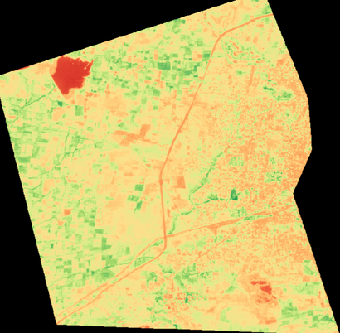
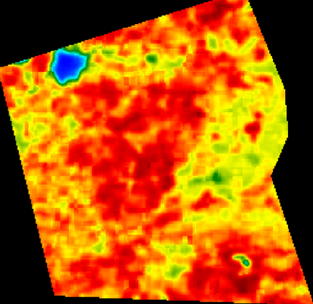
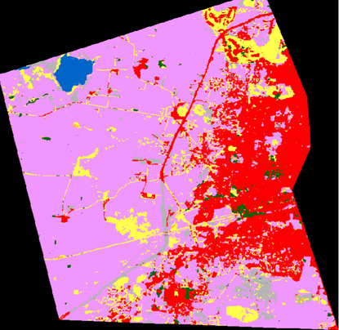
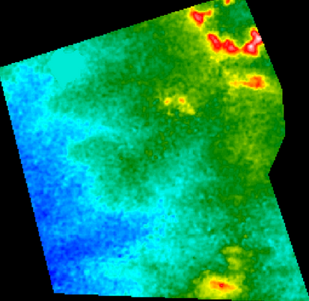
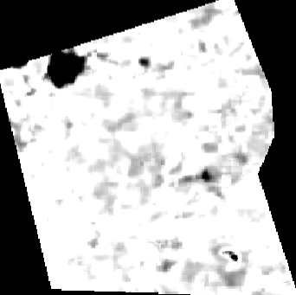
RASTER LAYERS
VEGETATION-NDVI
TEMPERATURE
LAND COVER
ELEVATION
POPULATION

Slide 7
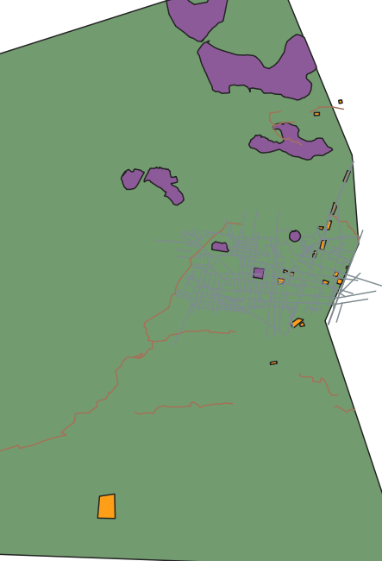
VECTOR LAYERS - I
LAYERS:-
Boundary(Green)
Forest(Purple)
River(Red)
Roads(grey)
Hospitals(yellow polygon)
Viral disease spots

Slide 8
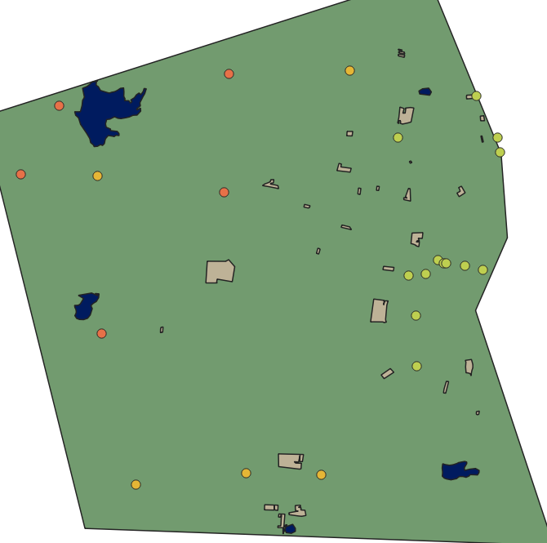
VECTOR LAYERS - II
LAYERS:-
Pharma(orange)
P.H.C(green)
Nursing(yellow)
Water body(blue)
Residential(brown)
WaterBorne disease

Slide 9
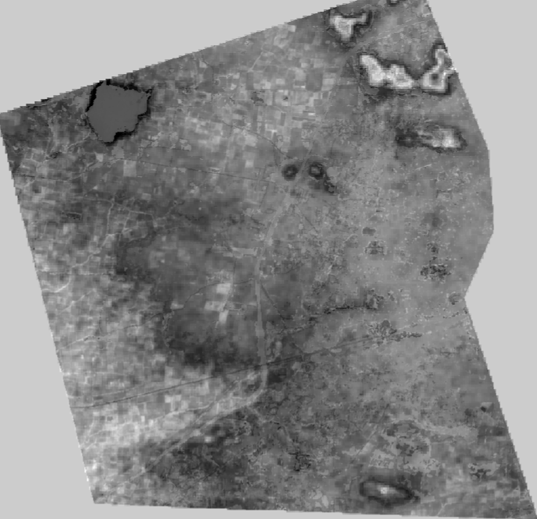
QUERIES AND ANALYSIS
01
RASTER
RASTER-BASED HEATMAP ILLUSTRATING ACCESS TO RURAL HEALTHCARE.
Weighted sum of 5 normalised raster layers
low elevation -0.25
low vegetation-0.25
high land cover-0.20
high temperature-0.20
high population-0.10

Slide 10
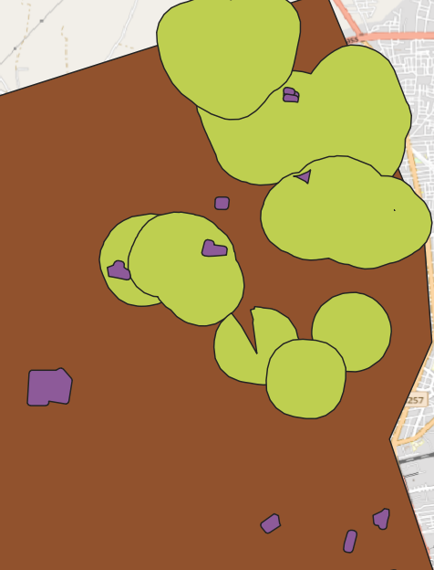
QUERIES AND ANALYSIS
02
VECTOR QUERY
OPTIMAL NEW HEALTHCARE FACILITIES
Finds residential buffer areas not served by nearby healthcare or roads but intersecting green spaces.
Highlights potentially underserved yet environmentally favorable zones for development or intervention.
(RES_BUFFER - (HEALTHCARE_BUFFER ∪ ROAD_BUFFER)) ∩ GREEN_BUFFER

Slide 11
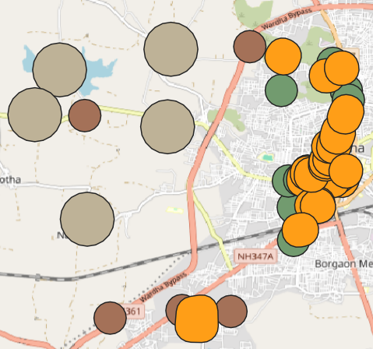
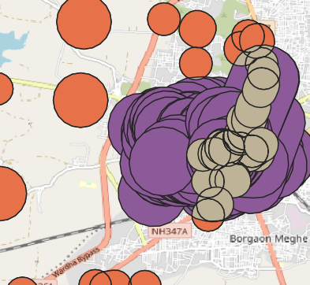
QUERIES AND ANALYSIS
03
VECTOR QUERY
ESTIMATION OF NEEDED ROAD NETWORK
Identifies healthcare facilities (PHCs, hospitals, nursing homes, pharmacies) located away from road networks.
Subtracts road buffer zones to highlight less accessible or remotely located facilities.
(PHC ∪ HOSP∪ NURSING ∪PHARMA)-BUFFER(ROADS)

Slide 12
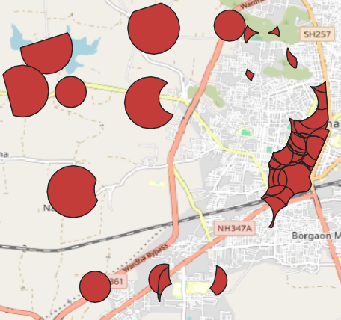
QUERIES AND ANALYSIS
04
VECTOR QUERY
CONSTRUCTION OF NEW HOMES WITH HEALTH ACCESS
Identifies healthcare facilities (PHCs, hospitals, nursing homes, pharmacies) outside residential buffer zones.
Clips the result to the administrative boundary to focus on the area of interest.
CLIP( (PHC ∪ HOSP∪ NURSING ∪PHARMA)-BUFFER(RESIDENTIAL)) BOUNDARY

Slide 13
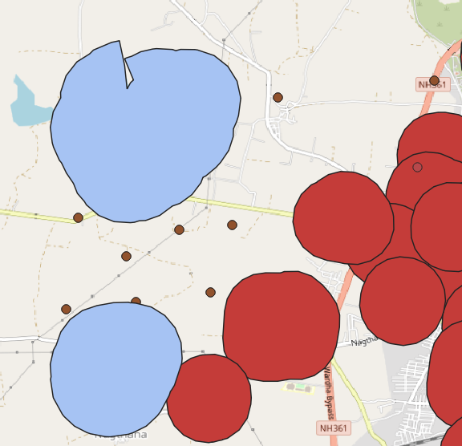
QUERIES AND ANALYSIS
05
VECTOR QUERY
WATERBORNE DISEASE RISK ZONES
Extracts waterborne disease cases that fall outside the influence zones of healthcare and residential buffers.
Applies symmetric difference to highlight underserved or potentially neglected risk areas.
SYM_DIF(WATERBORNE CASES- BUFFER(HEALTHCARE U RESIDENTIAL))

Slide 14
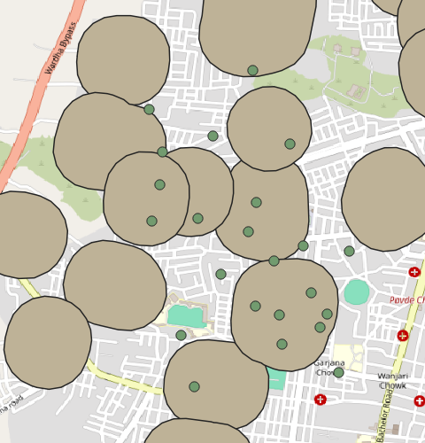
QUERIES AND ANALYSIS
06
VECTOR QUERY
VIRAL SPREAD IN HIGH POPULATION AREAS
Identifies viral disease cases located near healthcare facilities and residential areas.
Uses intersection of reported cases with a buffer around healthcare and residential zones.
INTERSECTION(REPORTED VIRAL CASES & BUFFER(HEALTHCARE U RESIDENTIAL))

Slide 15
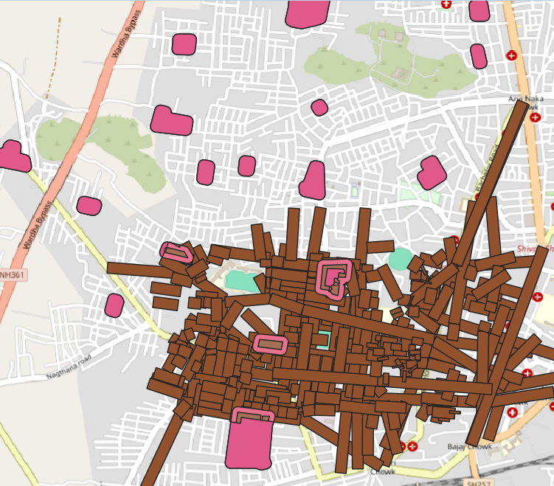
QUERIES AND ANALYSIS
07
VECTOR QUERY
OPTIMAL LOCATION FOR PHC
Placing new PHCs to improve healthcare accessibility in underserved neighborhoods
BUFF(RESIDENTIAL-ROAD)

Slide 16
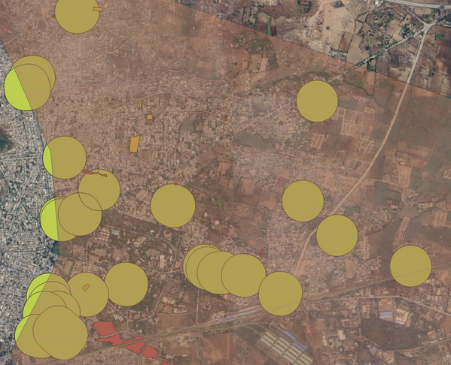
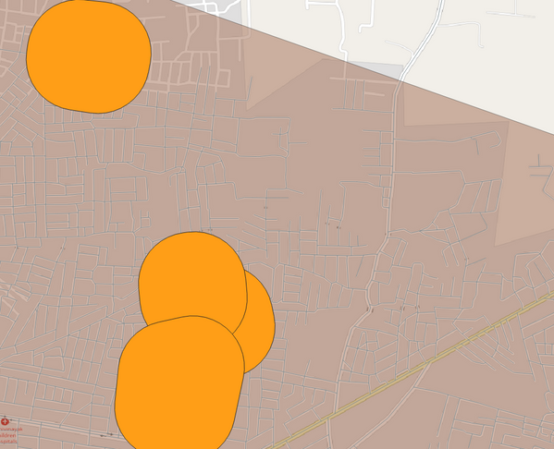
QUERIES AND ANALYSIS
08
VECTOR QUERY
PRIORITY ZONES FOR HEALTHCARE ZONES
Residential Complexes → 2 km buffer
We want to serve areas close to where people live.
Hospitals & PHCs → 2 km buffer
These are areas with coverage; we'll exclude them.

Slide 17
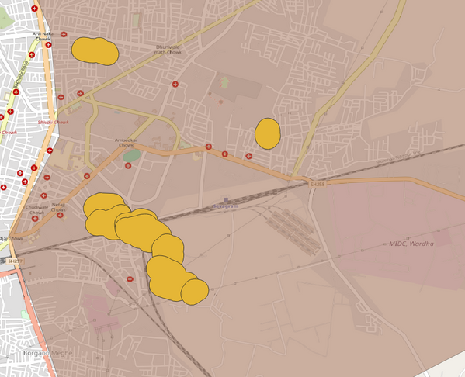
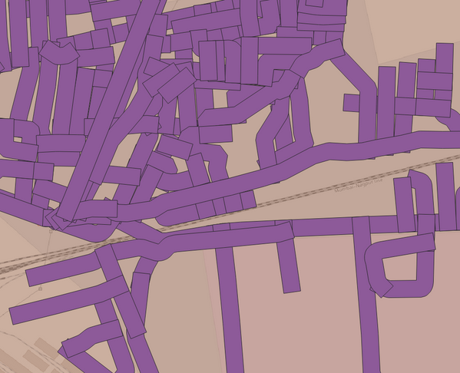
QUERIES AND ANALYSIS
09
VECTOR QUERY
PRIORITY ZONES FOR HEALTHCARE ZONES
Roads → 1 km buffer
Represents areas that are road-accessible.
Water Bodies & Forests → 1 km buffer
Exclusion zones (not ideal for setting up a facility).

Slide 18
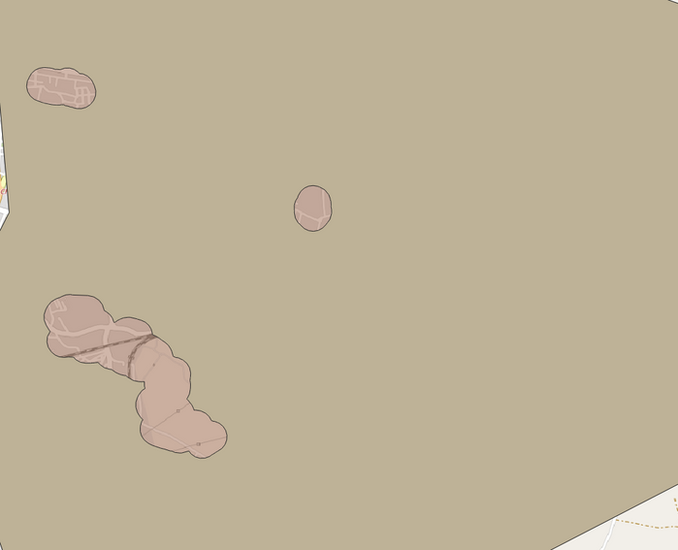
QUERIES AND ANALYSIS
VECTOR QUERY
10
PRIORITY ZONES FOR HEALTHCARE ZONES
Exclusion Zones
Union water_body_buffer and forest_buffer
Then subtract this union from the study area boundary:
Difference → Input: boundary, Overlay: exclusion_zones
Expression : Boundary_Polygon - (Water_buffer U Forest_Buffer)

Slide 19
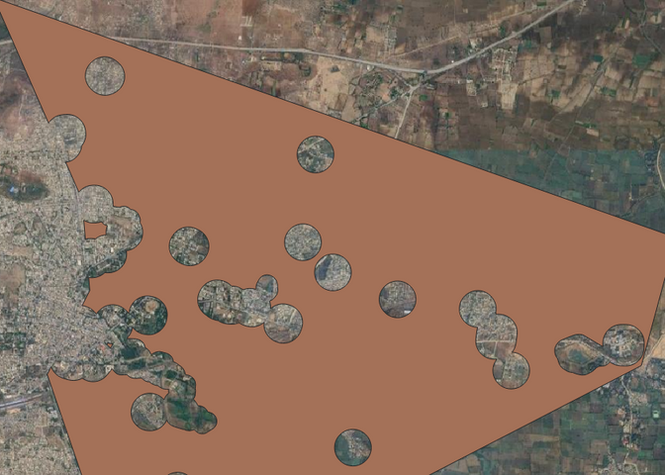
QUERIES AND ANALYSIS
VECTOR QUERY
11
PRIORITY ZONES FOR HEALTHCARE ZONES
Covered Zones (served by existing hospitals/PHCs)
Union hospital_buffer and phc_buffer → Output: served_area
Expression : Boundary_Polgon - (Hospital U PHC)

Slide 20
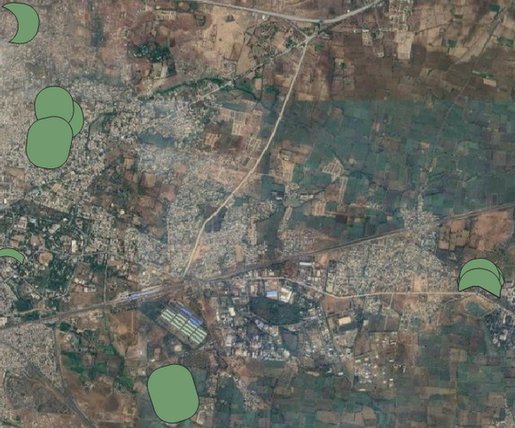
QUERIES AND ANALYSIS
VECTOR QUERY
12
PRIORITY ZONES FOR HEALTHCARE ZONES
Hot-Spot Identification
The result highlights hotspot zones where healthcare facilities can be prioritized because they are both buildable and close to residential populations.
Expression : Buildable_Area ∩ Residential_Complex

Slide 21
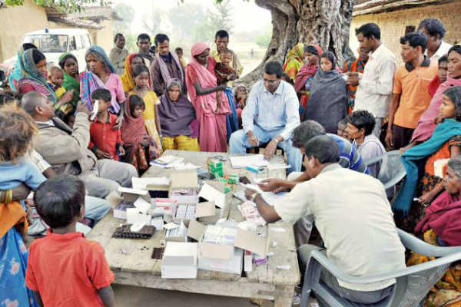
MARKET RESEARCH
Relevance: Over 65% of India’s population lives in rural areas, yet access to healthcare remains limited due to poor infrastructure and distance.
Who’s Working: Organizations like NITI Aayog, NHSRC, and private players like WISH Foundation are actively researching and addressing gaps.
Technology Use: Satellite data (like ISRO’s Bhuvan & NASA’s Night Lights) and GIS tools (QGIS, ArcGIS) help map underserved regions.
Recent Trends: Mobile health units, telemedicine, and AI-driven health mapping are emerging to improve rural reach.

Slide 22
THANK YOU

